Slide 1
Introduction to Data Ingestion
Process of collecting, importing, and transferring data from various sources into a storage system (e.g., HDFS, Data Lake).
Goal: Ensure that data from multiple formats (structured, semi-structured, unstructured) is available for processing and analysis.
Types of ingestion:
Batch ingestion: Data collected periodically (e.g., daily import)
Real-time/streaming ingestion: Data ingested continuously as it arrives

Slide 2
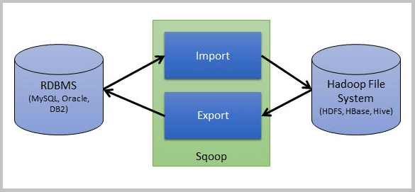
Sqoop (SQL-to-Hadoop)
A tool designed specifically for efficiently transferring bulk data between structured datastores (like relational databases) and Hadoop.
Analogy: A high-speed freight train. It’s not for small, constant packages. It’s for moving massive, pre-packaged shipments (entire tables or databases) from one station (your RDBMS) to another (HDFS).

Slide 3
Sqoop: Key Features
Bi-directional: Can import from RDBMS to HDFS and export from HDFS back to an RDBMS.
Parallel: Internally, it launches a MapReduce job to import/export data in parallel, making it fast and scalable.
Connector-Based: Uses JDBC (Java Database Connectivity) connectors to connect to almost any standard database (MySQL, Oracle, Postgres, SQL Server, etc.).
Snapshot-Oriented: Perfect for taking daily, weekly, or monthly snapshots of production databases for analytics.

Slide 4
How Sqoop Import Works
User Command: You run a sqoop import command, specifying the database, table, and HDFS target.
Inspects Metadata: Sqoop connects to the database, inspects the table's schema (column names, data types).
Code Generation (Codegen): It auto-generates a Java class to represent a record from your table.
Launches MapReduce Job: Sqoop submits a Map-Only MapReduce job to YARN.
Parallel Import: Each Mapper task is given a "split" of the data to import (e.g., Mapper 1 gets rows 1-1,000,000; Mapper 2 gets 1,000,001-2,000,000).
Write to HDFS: Each Mapper connects to the database, pulls its split, and writes the data as files in HDFS.
Key Takeaway: You don't write the MapReduce job; Sqoop does it for you. This is how it achieves high-speed, parallel data transfer.

Slide 5
Sqoop Import Example
Suppose you have a MySQL database named companydb containing a table called employees.
You want to import this table into HDFS under /user/hadoop/company/employees.
Option | Description
--connect | JDBC connection string to the source database
--username | Database username
--password | Password for the database
--table | Name of the table to import
--target-dir | HDFS directory where data will be stored
--m 1 | Number of map tasks (set to 1 for simplicity)
sqoop import \
--connect jdbc:mysql://localhost:3306/companydb \
--username root \
--password mypassword \
--table employees \
--target-dir /user/hadoop/company/employees \
--m 1

Slide 6
Sqoop Import Example
Example Table
emp_id | name | department | salary
101 | Alice | HR | 50000
102 | Bob | IT | 65000
After import, Sqoop creates a file in HDFS:
/user/hadoop/company/employees/part-m-00000
with contents like:
101,Alice,HR,50000
102,Bob,IT,65000

Slide 7
Sqoop Import Example
Import Using Query Instead of Table
sqoop import \
--connect jdbc:mysql://localhost:3306/companydb \
--username root \
--password mypassword \
--query "SELECT emp_id, name, salary FROM employees WHERE department='IT' AND \$CONDITIONS" \
--target-dir /user/hadoop/company/it_employees \
--split-by emp_id \
--m 2
\$CONDITIONS is mandatory when using --query (Sqoop replaces it during parallel execution).

Slide 8
Sqoop Import Example
To import only new or updated records:
sqoop import \
--connect jdbc:mysql://localhost:3306/companydb \
--username root \
--password mypassword \
--table employees \
--incremental append \
--check-column emp_id \
--last-value 102 \
--target-dir /user/hadoop/company/employees_incremental
This imports all records where emp_id > 102.

Slide 9
Sqoop Export Example
Option | Description
--connect | JDBC connection string to MySQL
--username / --password | Database credentials
--table | Target table in MySQL to receive exported data
--export-dir | HDFS directory containing data files (created earlier by Sqoop import or Spark job)
--input-fields-terminated-by ',' | Matches the delimiter used in HDFS data (important!)
--m 1 | Number of parallel map tasks (can increase for faster export)
Sending data from HDFS back into a MySQL table.
Now, assume you have processed or cleaned that data (maybe via Spark, Hive, or manually) — and you want to export it back into a new MySQL table called employees_cleaned.
sqoop export \
--connect jdbc:mysql://localhost:3306/companydb \
--username root \
--password mypassword \
--table employees_cleaned \
--export-dir /user/hadoop/company/employees \
--input-fields-terminated-by ',' \
--m 1
Make sure the target table exists in MySQL before export. If not, create it manually:

Slide 10
Sqoop: Summary
Usually, commands are run:
In the terminal of the Hadoop master node (NameNode or edge node)
Where Sqoop and Hadoop client utilities are installed
Typically, this node also has network access to your MySQL server
When executed:
Sqoop connects to MySQL via JDBC.
It retrieves metadata and splits the import into parallel map tasks.
Those MapReduce jobs run in the Hadoop cluster, writing output files to HDFS.
Requirement | Description
Hadoop installed | Working hdfs dfs commands
Sqoop installed | Check with sqoop version
Database reachable | Test with mysql -u root -p -h localhost
JDBC driver available | MySQL JDBC driver (mysql-connector-java.jar) must be in Sqoop’s lib folder

Slide 11
Sqoop: Python Integration
If you’re are learning and more comfortable in Python than in Hadoop CLI tools.
Sqoop commands themselves cannot run inside Python.
But —
You can trigger Sqoop from Python,
Or replicate what Sqoop does using Python libraries and frameworks.
Option 1: Call Sqoop from Python (Shell Integration)
Option 2: Do the Same Job Purely in Python (No Sqoop)
Option 3: Use PySpark Instead of Sqoop

Slide 12
Sqoop: Python Integration
Option 1: Call Sqoop from Python (Shell Integration)
If Hadoop and Sqoop are installed in the environment, Python can execute Sqoop commands as subprocess — just like running them in a terminal.
import subprocess
command = [
"sqoop", "import",
"--connect", "jdbc:mysql://localhost:3306/companydb",
"--username", "root",
"--password", "mypassword",
"--table", "employees",
"--target-dir", "/user/hadoop/company/employees",
"--m", "1"
]
subprocess.run(command, check=True)
This works if:
You have Hadoop & Sqoop installed
Python is running on the same machine
The database is reachable
Essentially, Python acts as a wrapper around Sqoop’s command-line utility.

Slide 13
Sqoop: Python Integration
Option 2: Do the Same Job Purely in Python (No Sqoop)
You can replicate Sqoop’s function — transferring data between MySQL and HDFS — using Python libraries.
Step 1. Read Data from MySQL
import pandas as pd
import mysql.connector
conn = mysql.connector.connect(
host="localhost",
user="root",
password="mypassword",
database="companydb"
)
df = pd.read_sql("SELECT * FROM employees", conn)
conn.close()

Slide 14
Sqoop: Python Integration
Option 2: Do the Same Job Purely in Python (No Sqoop)
You can replicate Sqoop’s function — transferring data between MySQL and HDFS — using Python libraries.
Step 2. Save Data to HDFS
If you have Hadoop running and want to push to HDFS:
from hdfs import InsecureClient
client = InsecureClient('http://localhost:9870', user='hadoop')
client.write('/user/hadoop/company/employees/employees.csv', df.to_csv(index=False), encoding='utf-8')
The hdfs library lets Python interact directly with the Hadoop filesystem.

Slide 15
Sqoop: Python Integration
Option 3: Use PySpark Instead of Sqoop
If your end goal is to bring relational data into a Hadoop/Spark environment, PySpark can handle this more naturally.
from pyspark.sql import SparkSession
spark = SparkSession.builder.appName("MySQL_to_HDFS").getOrCreate()
df = spark.read.format("jdbc").options(
url="jdbc:mysql://localhost:3306/companydb",
driver="com.mysql.cj.jdbc.Driver",
dbtable="employees",
user="root",
password="mypassword"
).load()
df.show()
df.write.csv("hdfs:///user/hadoop/company/employees", header=True)

Slide 16
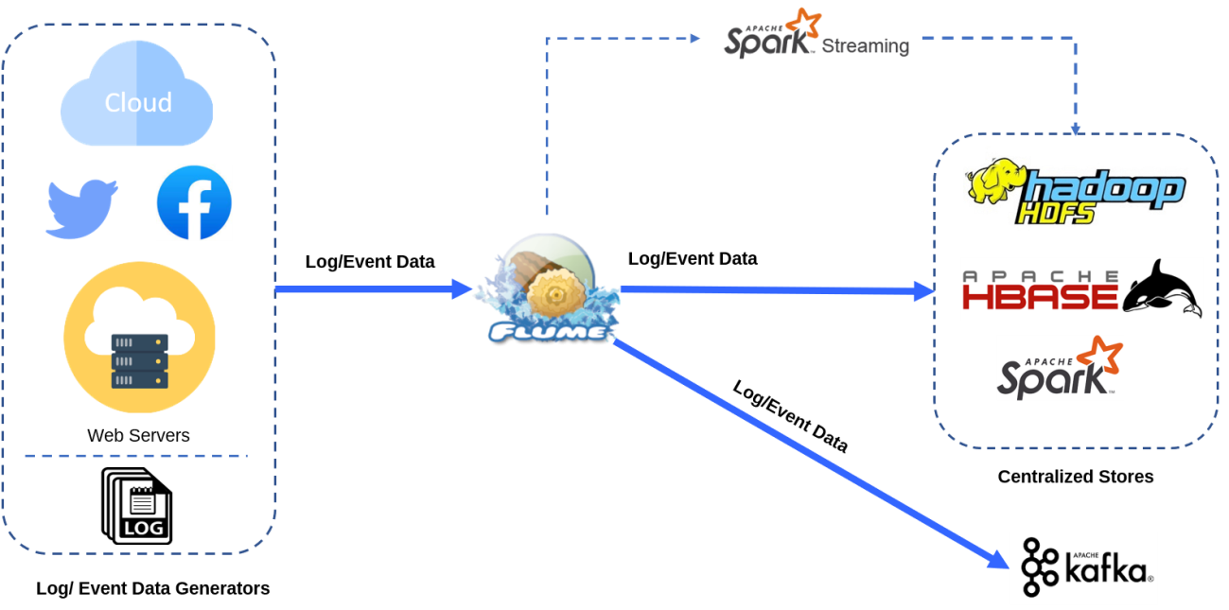
Flume
Apache Flume: The Real-Time Streaming Collector
A distributed, reliable, and available service for efficiently collecting, aggregating, and moving large amounts of streaming data.
Analogy:
A network of high-speed conveyor belts.
It's designed to catch a continuous, fast-moving stream of small items (log events, tweets, sensor data) and move them reliably to a destination.

Slide 17
Flume
Key Features:
Real-Time: Designed for high-throughput, low-latency data flow.
Reliable: Provides transactional guarantees between components to prevent data loss.
Scalable: Can "fan-in" data from thousands of sources and aggregate them.
Common Sources: Log files (tail), web servers, social media (Twitter), IoT devices.

Slide 18
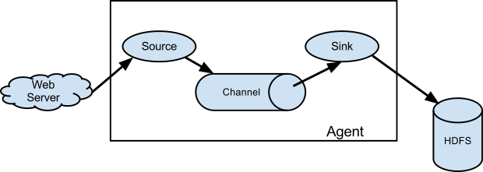
Flume Architecture
Flume's Core Components: Source, Channel, Sink
A Flume Agent is a JVM process that hosts the components to move data.
1. Source:
The "entry point." It receives data from the external source.
It "listens" for data (e.g., NetcatSource listens on a port, TwitterSource connects to the Twitter API).
It wraps the data into a Flume "Event" (headers + byte-array body).

Slide 19
Flume Architecture
2. Channel:
The "buffer." A temporary, transactional storage between the Source and Sink.
This is what makes Flume reliable. If the Sink fails, data piles up in the Channel instead of being lost.
3. Sink:
The "exit point." It removes Events from the Channel and sends them to the next destination.
Common Sinks: HDFSSink, KafkaSink, LoggerSink (for debugging).

Slide 20
Flume: Python Integration
Apache Flume itself is a Java-based tool, not a Python library — so you can’t “run Flume in Python” directly.
However, you can simulate Flume-like streaming behavior in pure Python using modules such as:
socket (for network streaming)
threading (for concurrent input/output)
os / io (for writing to files)
hdfs or pyarrow (if you want to push data to HDFS programmatically)
Flume Component | Python Equivalent
Source (Netcat) | socket server
Channel (Memory/File) | buffer.txt temporary file
Sink (HDFS) | hdfs Python client write

Slide 21
Sqoop vs. Flume: Which One to Use?
Feature | Apache Sqoop | Apache Flume
Data Type | Structured Data | Unstructured / Semi-Structured
Primary Use | Bulk Import / Export | Streaming / Real-Time Collection
How it Works | MapReduce Jobs (Connector-based) | Agents (Event-based)
Typical Data | RDBMS Tables (MySQL, Oracle) | Log files, Tweets, IoT sensor data
Data Flow | Batch. Runs, imports, then stops. | Continuous. Runs 24/7.
Main Analogy | Freight Train (Moves huge, pre-packed shipments) | Conveyor Belt (Moves a constant stream of small items)

Slide 22
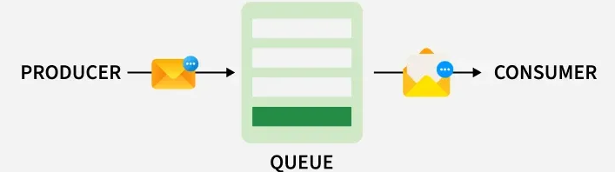
Message Queues
A component that enables asynchronous communication between different computer systems or applications.
Core Components:
Producer: The application that sends/publishes a message.
Consumer: The application that receives/subscribes to a message.
Queue/Topic: The buffer that stores messages until they are processed.
Popular Examples: Apache Kafka, RabbitMQ, Amazon SQS.

Slide 23
Message Queues: Why Use Them in Big Data?
1. Decoupling:
The producer and consumer don't need to know about each other.
The producer doesn't care if the consumer is slow, has crashed, or is being updated. It just sends the message to the queue.
2. Load Buffering (Shock Absorber):
Handles "spiky" traffic. If you suddenly get 1 million events from a web server (producer), your processing application (consumer) might crash.
The queue acts as a buffer, holding the 1 million messages and feeding them to the consumer at a sustainable pace.
3. Scalability & Reliability:
You can have many producers sending to one queue.
You can have many consumers reading from the same queue to parallelize processing.
Most queues offer persistence (saving messages to disk) so no data is lost if a server reboots.

Slide 24

Workflow Orchestration (Airflow)
Workflow Orchestration: The "Conductor" of Your Data Pipeline. Automation and scheduling of interdependent data processing tasks. Ensures that tasks run in the correct order with proper dependency management, retries, and monitoring.
The Problem: Real-world data pipelines are complex and have dependencies.
You can't start Step 2 (Train Model) until Step 1 (Ingest & Clean Data) is finished.
What if Step 1 fails? Should you retry? Should you send an alert?
What about running a report only on the first day of every month?
Core Concept: A workflow orchestration tool lets you author, schedule, and monitor complex data pipelines as code.

Slide 25
Oozie vs. Airflow
Feature | Oozie | Airflow
Workflow Definition | XML | Python
Flexibility | Limited to Hadoop jobs | Supports any task or API
UI/Monitoring | Basic | Advanced, real-time
Integration | Primarily Hadoop | Cross-platform (AWS, GCP, DBs, APIs)
Extensibility | Moderate | Highly extensible via custom operators
Modern Adoption | Declining | Widely used industry standard
Why Prioritize Airflow
Easier to code, debug, and maintain workflows
Integrates with modern data ecosystems
Provides better visualization, alerts, and retries
Ideal for complex data pipelines combining Hadoop, Spark, and cloud tools

Slide 26
Airflow's Building Blocks
1. DAG (Directed Acyclic Graph):
A workflow is defined as a DAG. It's the "container" for all your tasks.
It's a collection of tasks with defined dependencies.
Directed: Data flows in one direction. A -> B -> C.
Acyclic: No loops. C cannot depend back on A.
You define the DAG in a Python file.
2. Operator:
A "template" for a single unit of work.
Operators are the building blocks of a DAG.
Examples:
  BashOperator: Runs a bash command.
  PythonOperator: Runs a Python function.
  SparkSubmitOperator: Submits a Spark job.
  BigQueryOperator: Runs a SQL query in BigQuery.
3. Task:
A Task is a specific instance of an Operator.
dag = DAG(...)
run_sqoop_job = BashOperator(task_id='run_sqoop_job', bash_command='sqoop import ...', dag=dag)
run_spark_job = SparkSubmitOperator(task_id='run_spark_job', ...)

Slide 27
Airflow Core Concepts: Defining a Pipeline
A workflow is just a Python file.
You define the tasks (Operators) and then set their dependencies using bitshift operators (>> or <<).
Example Python Code (my_pipeline.py):
# 1. Define tasks
ingest_data = BashOperator(task_id='ingest_data', ...)
clean_data = SparkSubmitOperator(task_id='clean_data', ...)
train_model = PythonOperator(task_id='train_model', ...)
# 2. Define dependencies (the workflow)
# This means 'clean_data' runs after 'ingest_data'
# and 'train_model' runs after 'clean_data'.
ingest_data >> clean_data >> train_model

Slide 28
Airflow: ETL example
Simple Airflow Example: ETL Pipeline
Let’s say you want to:
Extract data from an API
Transform the data (clean/filter it)
Load it into a database (e.g., PostgreSQL or AWS S3)
We’ll build this with Airflow.

